Slide 1
FRONT END DEVELOPMENT
Working of a web page,
HTML,
CSS,
Javascript

Slide 2
How the web works
http://www.google.com
http://amrita.edu
Client←→ Server browser←→webserver
HTTP helps to communicate with client and server (structured)
HTTPS?
Notes:
URL uniform resource locator, resources are webpages, images text documents etc.. http+encryption document.body.contentEditable=true

Slide 3
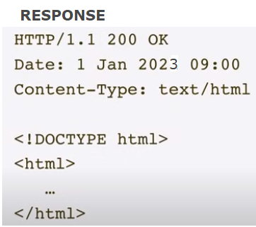
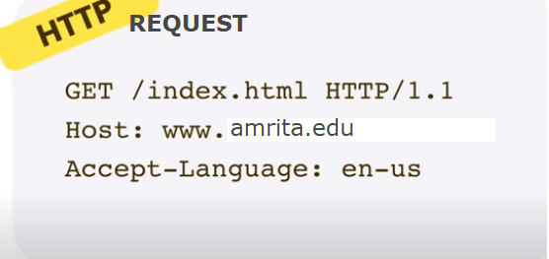
Notes:
Status code 200 successful or OK

Slide 4
Client Constructs DOM from the html
Document Object Model

Slide 5
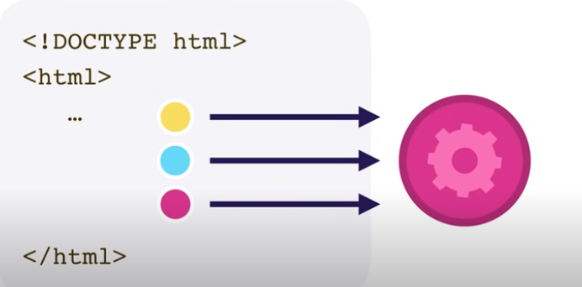
Index, html references other pages
Notes:
Again http requests to server

Slide 6
Render the webpage
Once all links are set, browser displays the webpage

Slide 7
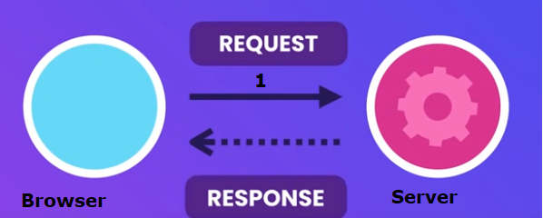
Web page access

Slide 8
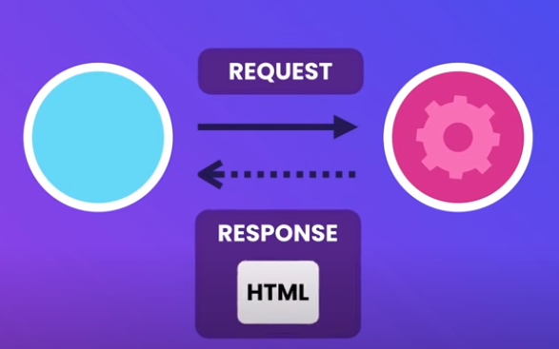
Web page access

Slide 9
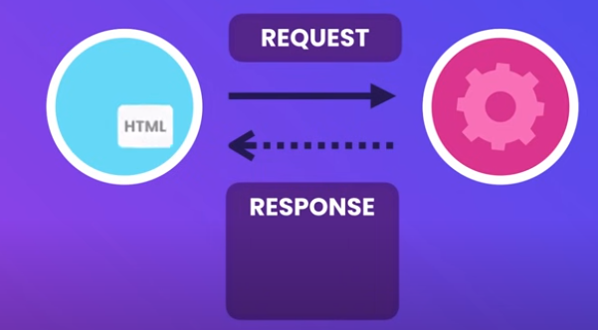

Slide 10
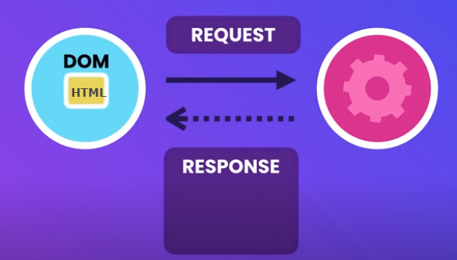
Notes:
Tree of html objects DOM

Slide 11
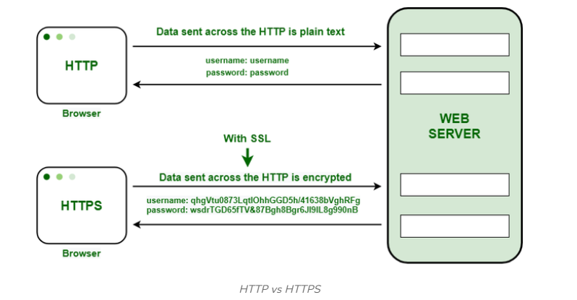
HTTP vs HTTPS

Slide 12
Try and check in browser
Inspect the network traffic etc..
http://quietfunglowinglight.neverssl.com/online/ - http page vs https page

Slide 13
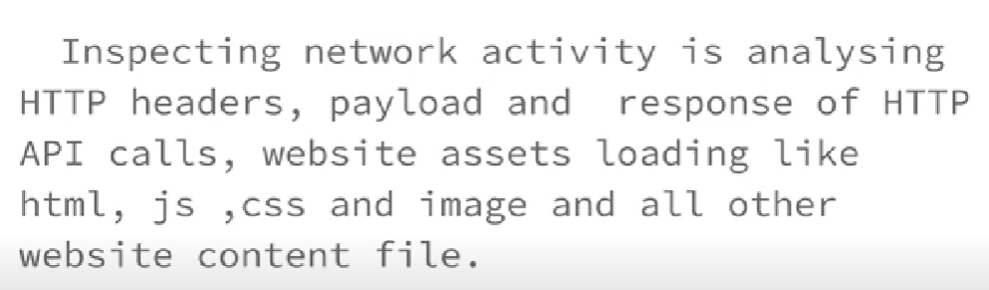

Slide 14
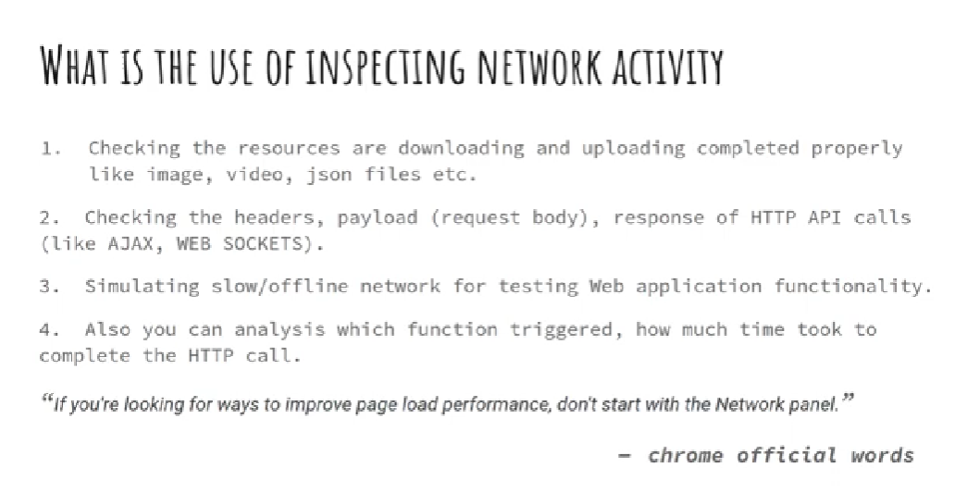

Slide 15
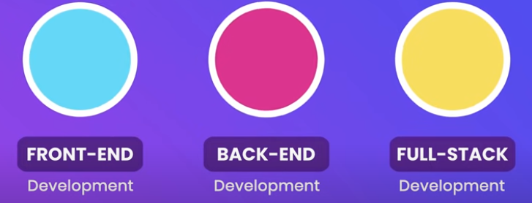
Web page development

Slide 16
Front end Languages
HTML,
CSS,
JavaScript

Slide 17
HTML
HyperText Markup Language - links that connect web pages to one another
to annotate text, images and other
content to display in a web browser
Language that drives web pages in WWW
Basic building block of the Web
Defines structure of the web content
Notes:
Interpret text, images and other contents using tags

Slide 18
Words to remember
Tag
Used to specify special regions to the web browser. Tags look like this: <tag>
Element
A complete tag, having an opening <tag> and a closing </tag>.
Attribute
Used to modify the value of the HTML element. Elements will often have multiple attributes.

Slide 19
Element?
An element consists of three basic parts: an opening tag, the element's content, and finally, a closing tag.
<p> - opening paragraph tag
Element Content - paragraph content
</p> - closing tag
Every webpage contains four basic elements. The html, head, title, and body elements.

Slide 20
4 basic elements of a Webpage
html,
head,
title, and
body.

Slide 21
Basic elements
<html> begins and ends each and every web page.
The <head> element comes next.
Tags placed within the head element are not directly displayed by browsers.
Place the <title> tag within the <head> element to title your page. The title will be displayed at the top of a viewer's browser.
The <body> element is where all content is placed. Paragraphs, pictures, tables, etc.

Slide 22
A Simple HTML File – ex1.html
<html>
<head>
<title>HTML Example</title>
</head>
<body>
Welcome to the world of HTML.
</body>
</html>

Slide 23
Tags
Tags are embedded commands within a document that communicates to the browser.
<opening tag> Content </closing tag>
Any number of white-spaces are compressed into a single one
Examples of Tags
<p>Paragraph Tag</p>
<h2>Heading Tag</h2>
<b>Bold Tag</b> or <strong> Bold Tag </strong>
<i>Italic Tag</i> or <em> Italic Tag </i>

Slide 24
More HTML tags
Tags Without Closing Tags
They still have the 3 basic parts (opening/closing and content).
do not require a formal </closingtag>
Examples:
<img src="mypic.jpg" /> -- Image Tag
<br /> -- Line Break Tag
<input type="text" size="12" /> -- Input Field
Notes:
None of <img />, <input /> or <button /> are HTML tags. They're XHTML tags. HTML tags never have a / before the closing >. <br/>

Slide 25
Attributes
HTML attributes provide additional information about HTML elements.
All HTML elements can have attributes
Attributes are always specified in the start tag
Attributes usually come in name/value pairs like name="value“
<html lang="en">

Slide 26
Common features
Tables
Frame
Form
Image map
Character Set
Meta tags
Images, Hyperlink, etc…

Slide 27
HTML Headings
HTML headings are defined with the <h1> to <h6> tags.
Each HTML heading has a default size.
However, you can specify the size for any heading
with the style attribute.
Eg <h1 style=“font-size:50px;”> Heading </h1>

Slide 28
HTML Paragraphs
The HTML <p> element defines a paragraph.
A paragraph always starts on a new line, and browsers
automatically add some white space (a margin)
before and after a paragraph.
Removes extra spaces

Slide 29
Line Breaks, Horizantal rule, Preformatted text
<br> element defines a line break
<hr>
<pre> element defines preformatted text.

Slide 30
Deeper into HTML elements

Slide 31
Classification of HTML elements
Main root
<html> - Represents the root (top-level element) of an HTML document, so it is also referred to as the root element. All other elements must be descendants of this element.

Slide 32
Document’s metadata
Metadata contains information about the page. This includes information about styles, scripts, and data to help software (search engines, browsers, etc.) use and render the page. Metadata for styles and scripts may be defined on the page or linked to another file that has the information.

Slide 33
Meta element tags | Description
<base> | Specifies the base URL to use for all relative URLs in a document. There can be only one such element in a document.
<head> | Contains machine-readable information (metadata) about the document, like its title, scripts, and style sheets.
<link> | Specifies relationships between the current document and an external resource. This element is most commonly used to link to CSS but is also used to establish site icons (both "favicon" style icons and icons for the home screen and apps on mobile devices) among other things.
<meta> | Represents metadata that cannot be represented by other HTML meta-related elements, like <base>, <link>, <script>, <style> and <title>.
<style> | Contains style information for a document or part of a document. It contains CSS, which is applied to the contents of the document containing this element.
<title> | Defines the document's title that is shown in a browser's title bar or a page's tab. It only contains text; tags within the element are ignored.

Slide 34
Sectioning root
Element | Description
<body> | represents the content of an HTML document. There can be only one such element in a document.

Slide 35
Content Sectioning
Content sectioning elements allow you to organize the document content into logical pieces.
Use the sectioning elements to create a broad outline for your page content, including header and footer navigation, and heading elements to identify sections of content.

Slide 36
Element | Description
<address> | Indicates that the enclosed HTML provides contact information for a person or people, or for an organization.
<article> | Represents a self-contained composition in a document, page, application, or site, which is intended to be independently distributable or reusable (e.g., in syndication). Examples include a forum post, a magazine or newspaper article, a blog entry, a product card, a user-submitted comment, an interactive widget or gadget, or any other independent item of content.
<aside> | Represents a portion of a document whose content is only indirectly related to the document's main content. Asides are frequently presented as sidebars or call-out boxes.
<footer> | Represents a footer for its nearest ancestor sectioning content or sectioning root element. A <footer> typically contains information about the author of the section, copyright data, or links to related documents.
<header> | Represents introductory content, typically a group of introductory or navigational aids. It may contain some heading elements but also a logo, a search form, an author name, and other elements.
<h1>, <h2>, <h3>, <h4>, <h5>, <h6> | Represent six levels of section headings. <h1> is the highest section level and <h6> is the lowest.
<hgroup> | Represents a heading grouped with any secondary content, such as subheadings, an alternative title, or a tagline.
<main> | Represents the dominant content of the body of a document. The main content area consists of content that is directly related to or expands upon the central topic of a document, or the central functionality of an application.
<nav> | Represents a section of a page whose purpose is to provide navigation links, either within the current document or to other documents. Common examples of navigation sections are menus, tables of contents, and indexes.
<section> | Represents a generic standalone section of a document, which doesn't have a more specific semantic element to represent it. Sections should always have a heading, with very few exceptions.
<search> | Represents a part that contains a set of form controls or other content related to performing a search or filtering operation.

Slide 37
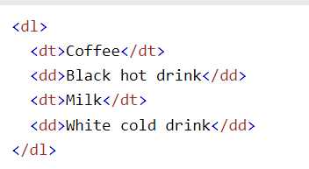
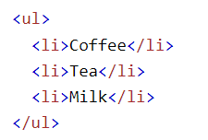
Text Content
<Blockquote>
<dl> → description list <dt> element <dd> description
<figure><figcaption>
<hr>
<li><ol><ul><menu>
<pre>

Slide 38
Inline Text Semantics
Use the HTML inline text semantic to define the meaning, structure, or style of a word, line, or any arbitrary piece of text.
<a>
<abbr>
<b>
<br>
<code>
<cite>
<em> <sub> <sup> <u>

Slide 39
Image and Multimedia
<area> | Defines an area inside an image map that has predefined clickable areas. An image map allows geometric areas on an image to be associated with hyperlink.
<audio> | Used to embed sound content in documents. It may contain one or more audio sources, represented using the src attribute or the source element: the browser will choose the most suitable one. It can also be the destination for streamed media, using a MediaStream.
<img> | Embeds an image into the document.
<map> | Used with <area> elements to define an image map (a clickable link area). The required name attribute of the <map> element is associated with the <img>'s usemap attribute and creates a relationship between the image and the map.
<track> | Used as a child of the media elements, audio and video. It lets you specify timed text tracks (or time-based data), for example to automatically handle subtitles. The tracks are formatted in WebVTT format (.vtt files)—Web Video Text Tracks.
<video> | Embeds a media player which supports video playback into the document. You can also use <video> for audio content, but the audio element may provide a more appropriate user experience.

Slide 40
Table tags etc.
Table tags are used to display data in a tabular format. Usually appears in <body> section. The tags also provides attributes that allows cells to span multiple rows and columns.
The <table> tag
The <th> tag
The <tr> tag
The <td> tag
The <td> tag with colspan and rowspan attributes.
The <caption> tag

Slide 41
forms tags
An HTML form is a section of a document that contains controls such as text fields, password fields, checkboxes, radio buttons, submit button, menus etc.
<form> is just another kind of HTML tag
HTML forms are used to create (rather primitive) GUIs on Web pages
Usually the purpose is to ask the user for information
The information is then sent back to the server
A form is an area that can contain form elements
Form elements include: buttons, checkboxes, text fields, radio buttons, drop-down menus, etc

Slide 42
Other kinds of HTML tags can be mixed in with the form elements
A form usually contains a Submit button to send the information in the form elements to the server
HTML forms can be used without JavaScript, and
JavaScript can be used without HTML forms, but they work well together

Slide 43
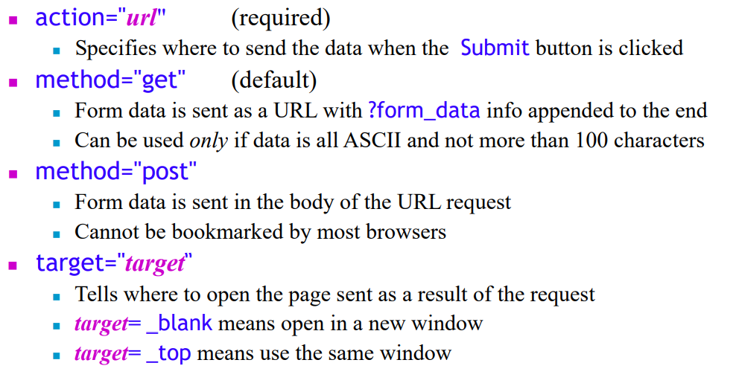
form tag

Slide 44
Form tag - eg
<form action=“sample.html” method=“GET”> <label for="fname">First name:</label> <input type="text" id="fname" name="fname"> <label for="lname">Last name:</label> <input type="text" id="lname" name="lname">
< input type =“submit” value=“SUBMIT” > </form>

Slide 45
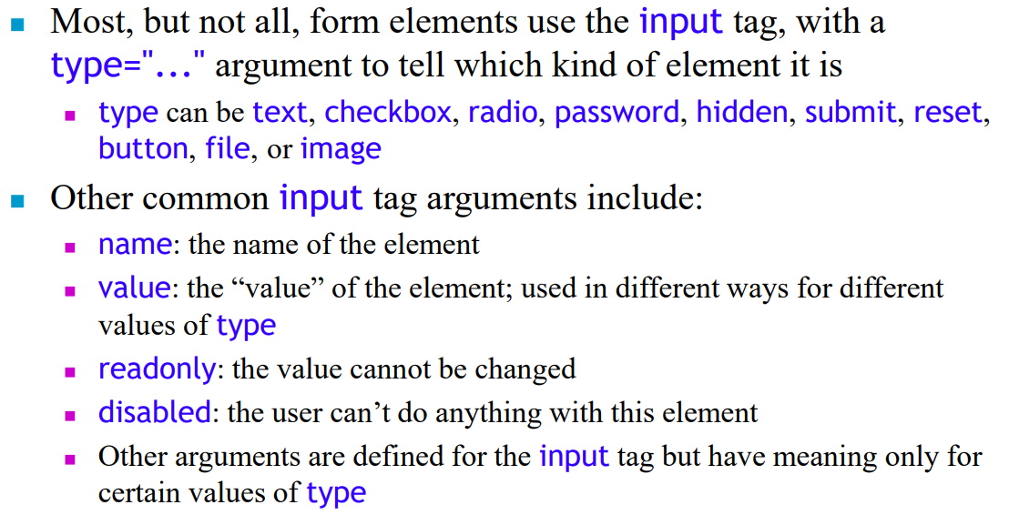
Input tag

Slide 46
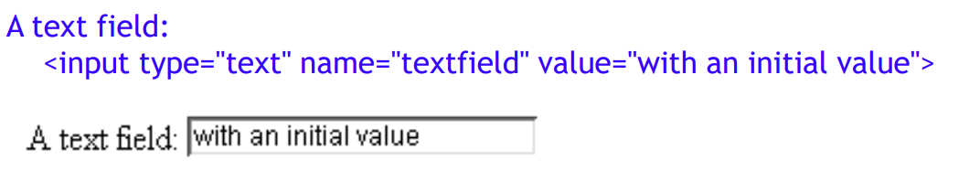
Eg : input tag

Slide 47
Label tag
The <label> tag defines a label for several form elements:
Like input type, select etc.

Slide 48
Label tag - eg
<label for="name">Your name:</label> <input type="text" id="name" name="name1">
Or
Name : <input type="text" name="name1">

Slide 49
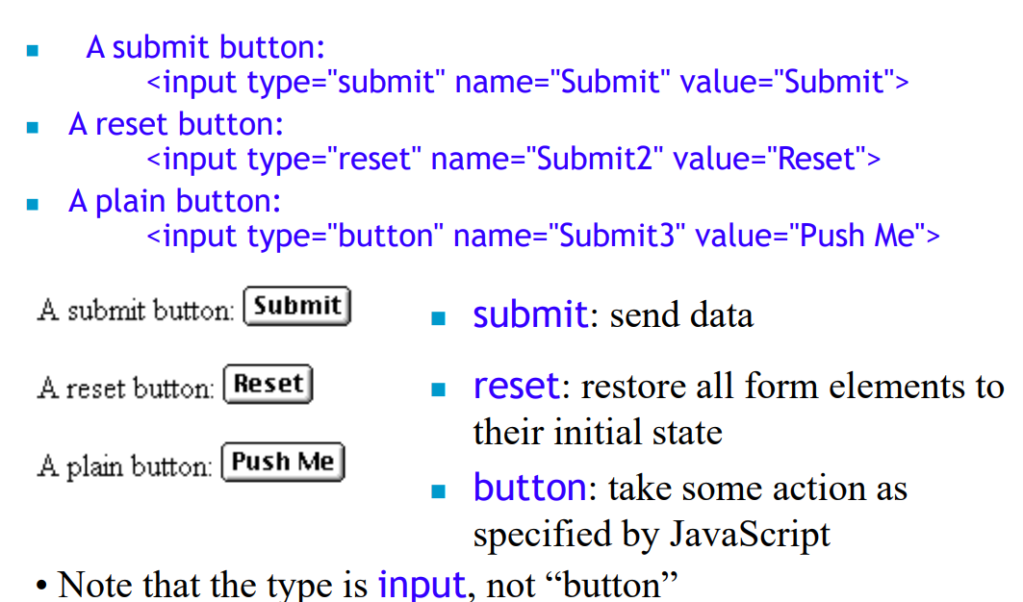
Buttons – not a tag

Slide 50
<button> tag
The <button> tag defines a clickable button.
Inside a <button> element you can put text (and tags like <i>, <b>, <strong>, <br>, <img>, etc.).
That is not possible with a button created with the <input> element!
Always specify the type attribute for a <button> element, to tell browsers what type of button it is.

Slide 51
Button tag eg
<button type="button" onclick="alert('Hello world!')">Click here</button>

Slide 52
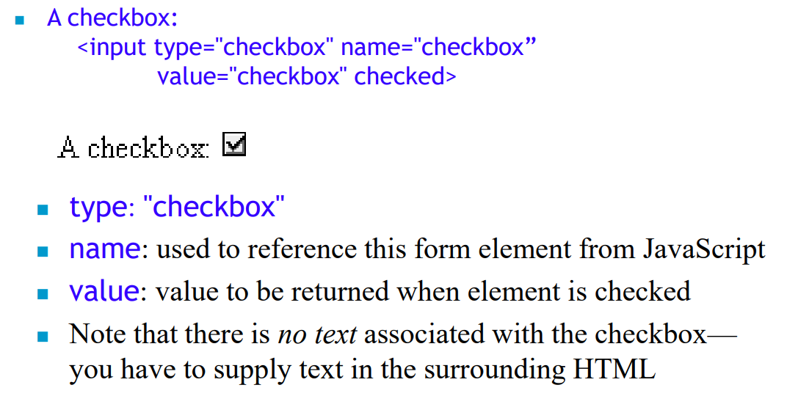
Checkbox – not a tag

Slide 53
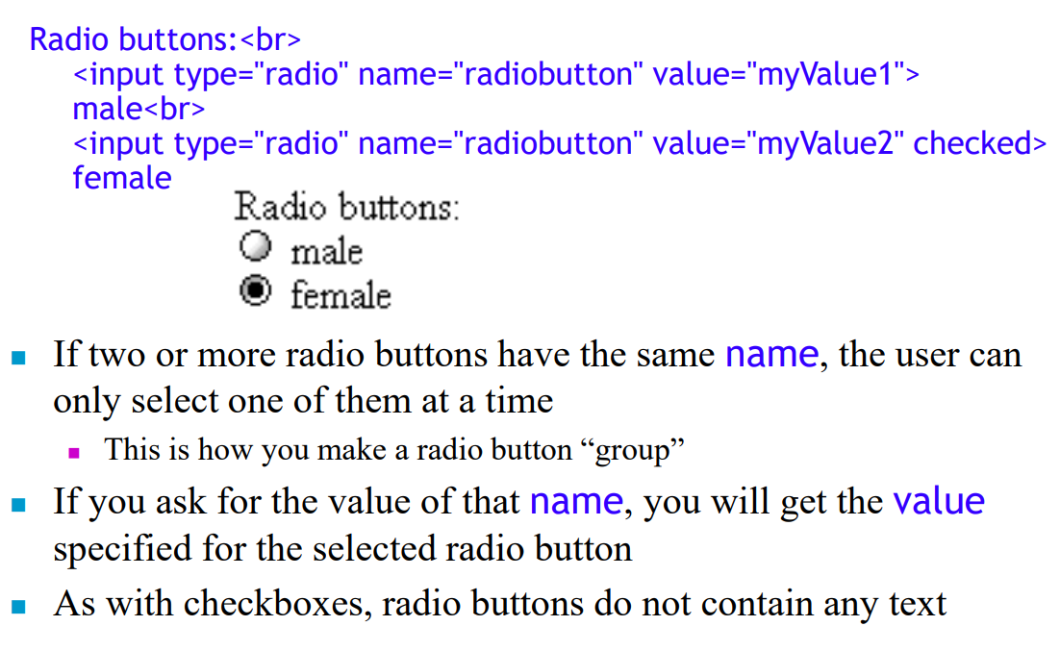
Radio buttons

Slide 54
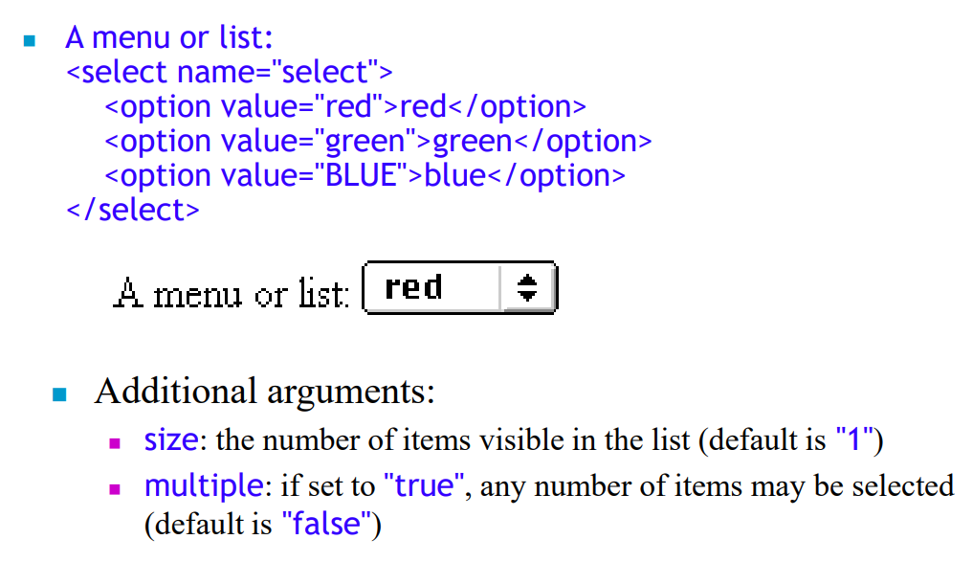
Menu – select tag

Slide 55
Menu - eg
<select id=“colors" name="color" size="3“ multiple>
<option value=“Red”>
<option value=“Blue”>
<option value=“Green”>
</select>

Slide 56
Datalist tag vs Select tag
Generally, both the tags are used for choosing an option from the given list.
But the main difference between both is that
in the <datalist> tag the user can enter its own input and add that as
an option with the help of the <input> element
whereas
the <select> tag doesn’t provide this feature.

Slide 57
Datalist- eg
<input list="courses" name="subject" id="cours">
<datalist id="courses">
<option value="DSA">
<option value=“Full Stack Development">
</datalist>
Note that to use the <datalist> tag, the id of the tag must be the same as of the <input> element attribute.

Slide 58
Div tag ?
try

Slide 59
Lab exercises
Make a request for a website and inspect in the developer tool – USEFUL FOR ANALYSIS PART OF YOUR ENDSEM PROJECT
Analyse the number of requests made, the network traffic, types of requests, number of img requests, document requests, use filters etc...
For reference : https://developer.chrome.com/docs/devtools/performance/
https://www.headspin.io/blog/chrome-devtools-a-complete-guide
Create your profile as a simple webpage with your creativity.
Name
Photo
Use the components explained so far. (with default attributes)
Use the components with modified attributes.(width, size, color etc.)
Upload in the link below:
_________________________
Notes:
https://developer.chrome.com/docs/devtools/performance/
https://www.youtube.com/watch?v=Uuaue9odUEo&t=11s

Slide 60
Create a webpage as given
Design a website for Amrita College( any campus).
There should be at least 5 web-pages present in the web-site.
There should be: • One Home page that leads to other pages. The Home page should contain the name of the college as heading along with the college logo.
There should be a tab with the following links: • Home; • Academics; • Admission; • Gallery. • There should be an appropriate description of the college on the home page. • One Academics page which contains a list of all the departments present in the college Arts, Science and Commerce. The list should be a nested list, with available courses mentioned under each department. There should be a minimum of two courses under each department, (for e.g. Computer Science and Mathematics under Science, English and Sociology under Arts and so on). Each Course entry in the list should be a HTML link that leads to a web-page totally dedicated to the course itself. • Each Course should have its own dedicated web-page. This page should contain a description about the course, a list of all the teachers taking the course and the timetable for that particular subject. One gallery page that contains set of photos taken of the college and its students. Please note that each web-page in this website should have the same background Image/color. The looks of each page should be similar.

Slide 61
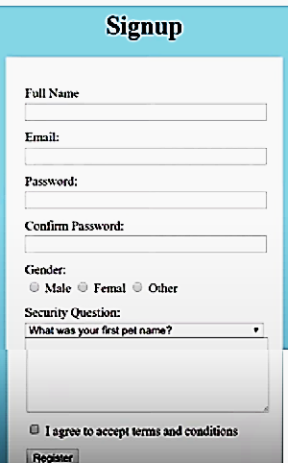
a. Create the following form

Slide 62
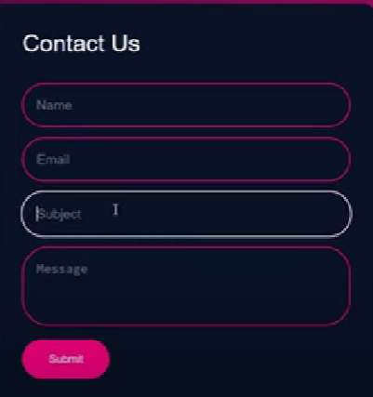
Send an email to your gmail without using any back end
Notes:
“https://formsubmit.com/your@email.com” https://www.youtube.com/watch?v=iSobU_DjNN4

Slide 63
https://formsubmit.co/?utm_source=formsubmit.co&utm_medium=site%20link&utm_campaign=submission%20page
Include Captcha for sending a message

Slide 64
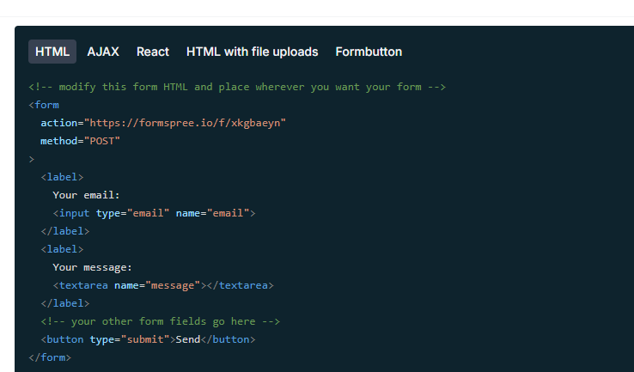
https://formspree.io/

Slide 65
</forms> <form action="https://formsubmit.co/dradhamadhavan@gmail.com" method="POST"> <label for="fname">First name:</label> <input type="text" id="fname" name="fname"><br><br> <label for="email">email</label> <input type="email" id="email" name="email"><br><br> <textarea name="message"> type here</textarea> <input type="submit" value="Submit"> </form>

Slide 68
Github git lab, big bucket

Slide 69
https://www.mobindustry.net/services/web-app-development/

Slide 70
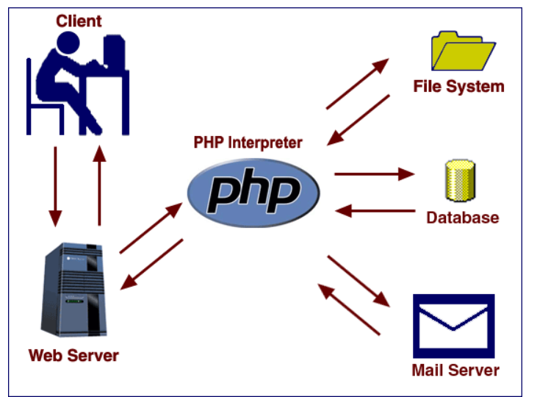
https://patriciasdesignsite.wordpress.com/2015/02/19/the-difference-between-html-css-javascript-and-php-languages/

